Slide 1
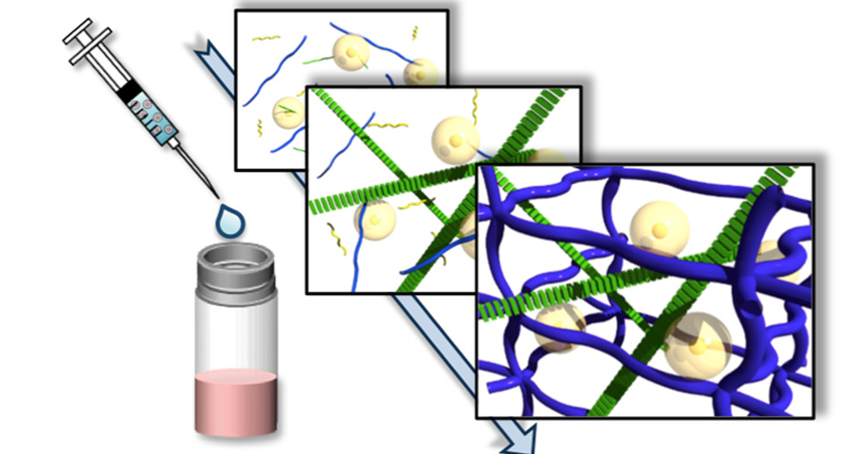
Interpenetrating polymer networks (IPNs)
M.Sc.- First Semester -2023-2024

Slide 2
INTERPENETRATINC POLYMER NETWORKS (IPNs)
The IPNs may be considered belonging to the class of polymer blends. Polymer blends are systems containing two or more polymer components, which may be classified into two categories: mechanical blends in which no chemical bonds are formed between the two polymers and graft copolymers containing primary bonds between the polymeric components. Graft copolymers are further divided into subclasses according to the presence or absence of cross-linking between the components. Particularly, when both polymers are cross-linked, the resulting materials are known as “interpenetrating polymer networks,” IPNs.
INTERPENETRATINC POLYMER NETWORKS (IPNs) are deﬁned as a combination of two or more polymers in network form that are synthesized in juxtaposition. Thus, there is some type of “interpenetration.” However, the term interpenetrating polymer network was coined before current aspects of phase separation and morphology were understood. Now we know that most IPNs do not inter-penetrate on a molecular scale; they may, however, form ﬁnely divided phases of only tens of nanometers in size. Many IPNs exhibit dual phase continuity, which means that two or more polymers in the system from phases that are continuous on a macroscopic scale.

Slide 3
INTERPENETRATINC POLYMER NETWORKS (IPNs)
When two or more polymers are mixed, the resulting composition can be called a multicomponent polymer material.
There are several ways to mix two kinds of polymer molecules:
Simple mixing, as in an extruder, results in a polymer blend.
If the chains are bonded together, graft or block copolymers result
Bonding between some portion of the backbone of polymer I and the end of polymer II, the result is called a graft copolymer
Chains bonded end to end result in block copolymers.

Slide 4
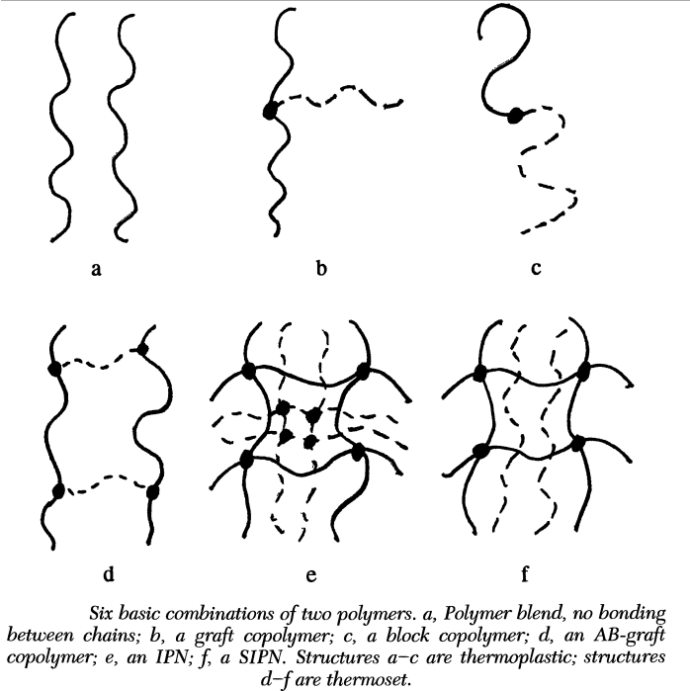
INTERPENETRATINC POLYMER NETWORKS (IPNs)
In many ways, IPNs are related most closely to block copolymers. In the block copolymer systems, the length of the block determines the size of the domains. Correspondingly, the cross-link level (length of chain between cross-links) plays a major role in determining the domain size of IPNs. Short blocks or short chain segments between cross-links both make for small domains under many conditions. However, there are some important differences. Short block lengths are important because they increase miscibility between component polymers. For the case of IPNs, there is growing evidence that cross-links decrease the miscibility of the system relative to the corresponding blend, for systems in which the linear component polymers are miscible.

Slide 5
Kinds of IPNs
There are mainly two different types of classification for IPNs systems:
The first type of classification is based on the chemical bonds existing between the polymeric components of the resulting IPN network. Therefore, based on the chemical bonding it is possible to distinguish:
• Covalent semi-IPN: a single polymeric network is formed by the two separate polymer
systems that are cross-linked.
• Noncovalent semi-IPN: only one of the polymer systems is cross-linked.
• Noncovalent full-IPN: the two separate polymers are cross-linked independently.

Slide 6
Kinds of IPNs
A second classification is based on the synthetic procedure. In this context, it is possible to find:
Sequential IPN. Polymer network I is made. Monomer II plus cross-linker and activator are swollen into network I and polymerized in situ. The sequential IPNs include many possible materials where the synthesis of one network follows the other.
Simultaneous interpenetrating network (SIN). The monomers or prepolymers plus cross-linkers and activators of both networks are mixed. The reactions are carried out simultaneously, but by noninterfering reactions. An example involves chain and step polymerization kinetics.
Latex IPN. The IPNs are made in the form of latexes, frequently With a core and shell structure. A variation is to mix two different latexes and then form a ﬁlm, which cross-links both polymers. This variation is sometimes called an interpenetrating elastomer network (IEN).

Slide 7
Kinds of IPNs
Gradient IPN. Gradient IPNs are materials in which the overall composition or cross-link density of the material varies from location to location on the macroscopic level. For example, a ﬁlm can be made with network I predominantly on one surface, network II on the other surface, and a gradient in composition throughout the interior.
Thermoplastic IPN. Thermoplastic IPN materials are hybrids between polymer blends and IPNs that involve physical cross-links rather than chemical cross-links. Thus, these materials ﬂow at elevated temperatures, similar to the thermoplastic elastomers, and at use temperature, they are cross-linked and behave like IPNs. Types of cross-links include block copolymer morphologies, ionic groups, and semi-crystallinity.
Semi-IPN. Compositions in which one or more polymers are cross-linked and one or more polymers are linear or branched are semi-IPN (SIPN).

Slide 8
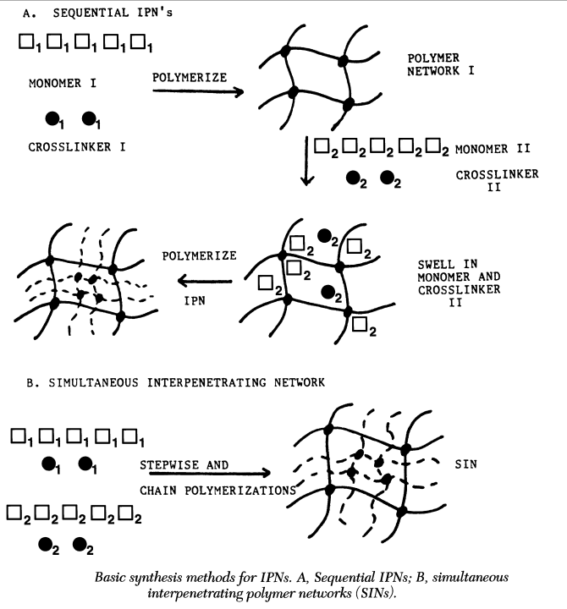

Slide 9
Domain Shapes and Sizes
Polymerization of IPNs may result in four distinct stages of morphology development:
At first, monomer II may be soluble in polymer (or network) I. During this first stage of polymerization, polymer II also remains soluble. At this stage, the polymerizing system may be optically clear.
As polymerization proceeds to stage 2, it suddenly clouds up, which indicates phase separation. This phase separation may be nucleation- and growth-controlled spheres.
In stage 3 of continued polymerization, interconnected cylinders develop and increase in number during the latter stages of polymerization, indicative of spinodal decomposition.
In stage 4, themorphology may become less distinct because the high viscosity of the system very significantly reduces diffusion toward the equilibrium state.
The morphology of an IPN depends on the cross-linking level of networks I and II. There are several cases to consider. If there are no cross-links, a solution graft copolymer exists. If the solution is stirred during the polymerization, a phase inversion takes place. For the polybutadiene-blend-polystyrene system, high-impact polystyrene (HIPS) results. If the system is not stirred, it does not undergo phase inversion and polybutadiene remains the continuous phase.

Slide 10
Domain Shapes and Sizes
If the polymers are cross-linked, there are several additional cases to be considered. First and most general, the following question must be asked: Did phase separation or gelation happen first? This question is particularly important for simultaneous interpenetrating networks. If phase separation occurs before gelation, then the phase domain sizes will tend to be large. When gelation finally occurs, it will tend to keep the domains apart. If gelation happens first, the presence of cross-links will tend to keep the domains much smaller. Here, spinodal coarsening and aging are suppressed. Obviously, if both polymers reach gelation at different times, further questions must be asked about the time sequence of events.
For the sequential IPNs, the presence of a cross-linked network I always guarantees that gelation happens before phase separation because (in the simplest case) gelation has happened before monomer II is added.
If only polymer II is cross-linked, then a quite different situation exists.
The morphology is as important for the development of good damping properties as it is important for the development of tough plastics. Dual phase continuity leads to an increase in the area under the loss modulus-temperature curve in the vicinity of the glass transitions. For very small domain sizes, only one broad glass transition is observed. For tough, impact-resistant plastics, where the domains are larger and the two polymers are better separated, two distinct glass transitions are often observed.

Slide 11
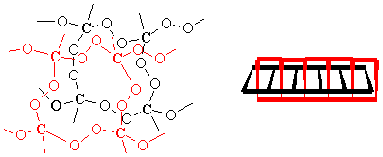
Full and Semi IPNs
Full IPNs
Both components of a full IPN are present as cross-linked networks, although there is negligible bonding between the two polymers. These can be prepared sequentially or simultaneously. Although the constituent polymers are incompatible, phase segregation is constrained by network formation, leading to small phase domains, and hence the potential for homogenization of the properties. Because of the small domains, IPNs can yield transparent materials even if the components have large refractive index differences.
Since the glass transition temperature becomes size dependent for small domains, only one transition is expected for IPNs. However, a distribution of phase sizes gives rise to very broad glass transitions (with respect to both the temperature and frequency), a property exploited in acoustic damping and vibration isolation applications.

Slide 12
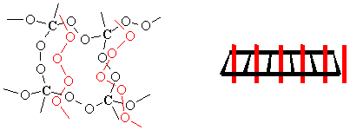
Full and Semi IPNs
Semi- or Pseudo-IPNs
One of the components of these IPNs has a linear structure instead of a network structure. A molecular and geometric depiction of this structure is given below. The linear component changes some of the properties of the IPN. Some of these IPNs can be extruded if the linear component is making up a majority of the material. One thing to keep in mind is that the linear component of the IPN can be removed from the network if the material is swollen in the appropriate solvent. These types of IPNs can be formed by either a sequential or simultaneous process. To further complicate the issue, IPNs of this type that are made by a sequential process are called semi-IPNs and the ones made by a simultaneous process are pseudo-IPNs.

Slide 13
Thermoplastic IPNs
As the name implies, these IPNs are moldable, can be extruded, and can be recycled. At least one component of these IPNs is usually a block copolymer, like SBS rubber . The other component is typically a semi-crystalline or glassy polymer. These IPNs have completely thrown the idea of chemical crosslinks out the window and use physical crosslinks, like thermoplastic elastomers. Typical physical crosslinks arise from ionic groups, crystallinity, or glassy domains.
Latex IPNs
One of the problems with most IPNs is that they can't be molded after they are formed since they are thermosets. One way of getting around this problem is to use a latex IPN. These IPNs are formed by an emulsion polymerization. The morphology of IPN depends upon how the IPN components are polymerized. Both monomers can be added at once, which will tend to give you a more uniform morphology in the particles (a simultaneous IPN formation). The monomers can also be added in stages. For instance monomer 1 can be polymerized to form a latex and monomer 2 can then be added (a sequential IPN formation). Depending on how fast monomer 2 diffuses into the latex, one can get either a homogeneous incorporation of the monomer into the latex or most of monomer 2 may react near the surface of the latex particle. If most of monomer 2 reacts near the surface, one has a core-shell morphology.

Slide 14
Smart alginate IPNs and semi-IPNs
Stimuli-responsive hydrogels have attracted great interest recently due to their potential application in the field of drug delivery, tissue engineering, and biosensors. These polymers are able to be responsive to a number of stimuli, such as temperature, pH, and electrical or magnetic field. Among these stimuli, pH and temperature are the most extensively studied because they are the two important parameters for the human body functions. Several smart IPNs and semi-IPNs Alg-based systems are reported in literature in the form of hydrogels, beads, or microspheres.
Recently, Eswaramma et al. prepared dual responsive IPN microbeads composed of sodium Alg and modified guar gum. First, guar gum was modified by graft copolymerization using N-vinylcaprolactam (GG-g-PNVCL) and then IPN hydrogel microbeads of sodium Alg and GG-gPNVCL were prepared by water-in-oil emulsion cross-linking method using GA as cross-linker.

Slide 15
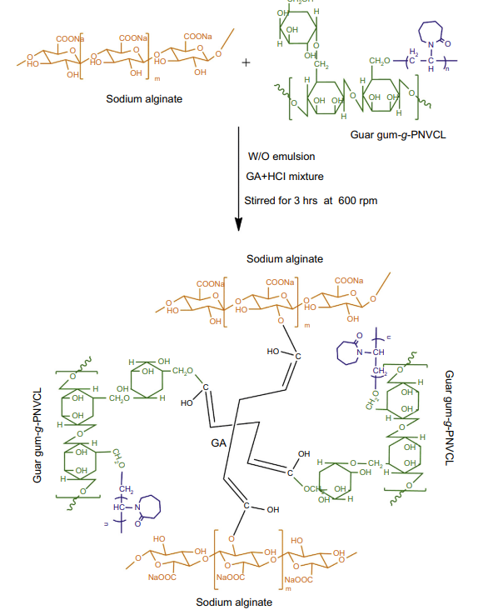

Slide 16
Chitosan-based IPNs semi-IPNs hydrogels
Many papers describe the development of IPN and semi-IPN based on unmodified CH combined with different polymers , Sampath et al. (2017) used nanocellulose, CH, and GA for the formation of a semi-IPN network. First, cellulose nanocrystals (CNCs) were extracted from microcrystalline cellulose via sulfuric acid hydrolysis. Then these nanocrystals were homogenized through ultrasonication and CH was added and cross-linked with GA to form Schiff base linkages.
The addition of CNCs (up to 2.5%) to CH hydrogels improved the maximum compression of thenetworks and led to the formation of a semi-IPN with several potential applications in the field of tissue engineering, pharmaceuticals, and drug delivery.

Slide 17
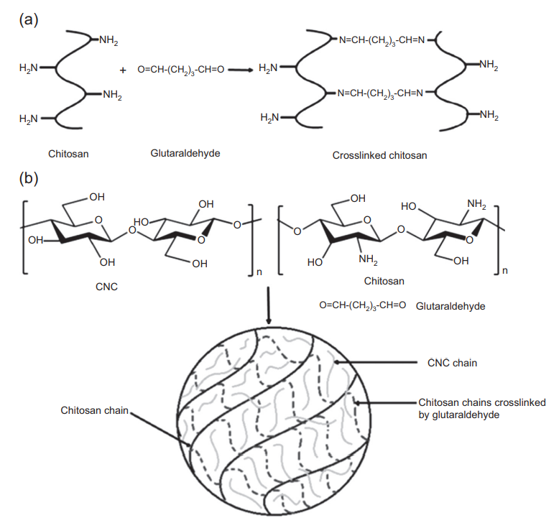
The schematic representation of the steps for the formation of CNC-chitosan hydrogel:
crosslinking process of chitosan with glutaraldehyde (a);
proposed mechanism for the formation of semi- interpenetrating polymer network hydrogel (b).

Slide 18
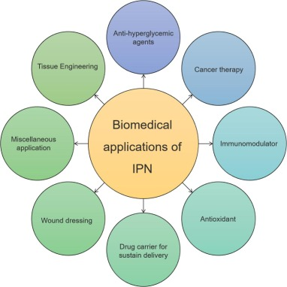
Applications of IPNs and semi-IPNs gels
The patent literature reveals that there are many products based on IPNs and semi IPNs systems, including adhesive, optically smooth surfaces, damping materials, and ion exchange resins. However, drug delivery and tissue engineering are two of the growing and interesting fields in which IPNs and semi-IPNs are widely used. The increasing interest in these materials is mainly due to the possibility of improving the mechanical properties of the single components by combining different kinds of natural and synthetic polymers, sterilization of the resulting networks because of the thermal stability of these materials compared with other types of hydrogels and a switch from laboratory to large-scale production

Slide 19
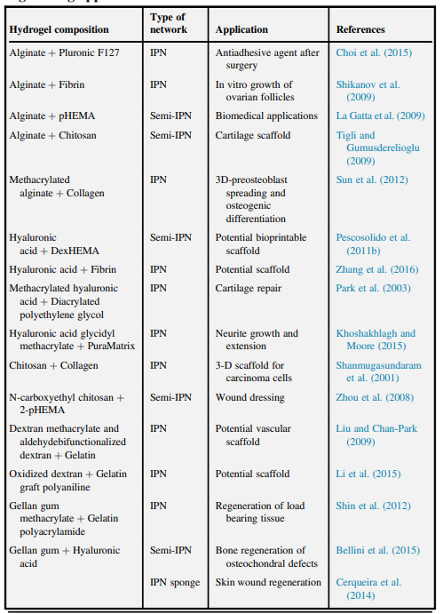

Slide 20
Thank You

